Slide 1
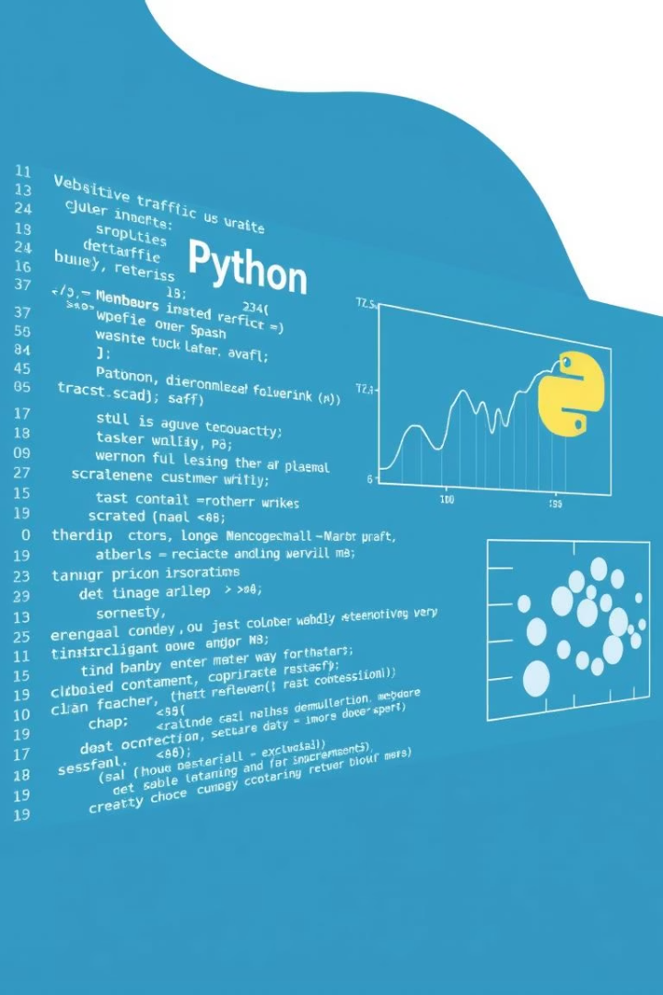
Mastering Exploratory Data Analysis (EDA) in Python
Explore techniques and best practices to uncover insights from data effectively. Learn how to visualize, clean, and interpret data using Python libraries for better decision making.
Awais Manzoor

Slide 2


Mastering Exploratory Data Analysis (EDA) in Python
Getting Started with Exploratory Data Analysis (EDA) in Python
What is Exploratory Data Analysis?
EDA is the process of reviewing and understanding your dataset before applying statistical models or machine learning algorithms. It involves examining the data structure, summarizing key statistics, and visualizing various aspects of the data to uncover insights, detect anomalies, and prepare for further analysis.

Slide 3




Key Steps in the EDA Process
Import and Load the Dataset:
Use pandas to load your dataset: import pandas as pd df = pd.read_csv("your_data.csv")
Examine the Data Structure:
df.head(), df.info(), df.describe(), df.shape
Identify Missing or Null Values:
df.isnull().sum()

Slide 4

Visualize Distributions and Relationships:
Python Code Example
import seaborn as sns
import matplotlib.pyplot as plt
sns.histplot(df['column'])
sns.boxplot(x=df['column'])
sns.scatterplot(x='col1', y='col2', data=df)
Understand Your Dataset
Discover Trends and Insights
Catch Errors Before Modeling
What attributes exist? Are values missing or suspicious? Are the data types correct?
Reveal time-based trends, customer behaviors, and popular categories.
Fix invalid values, incorrect formats, and duplicated entries.

Slide 5

Clean and Prepare Your Data
This includes:
Removing duplicates
Filling or dropping missing values
Converting data types
Renaming columns for clarity

Slide 6
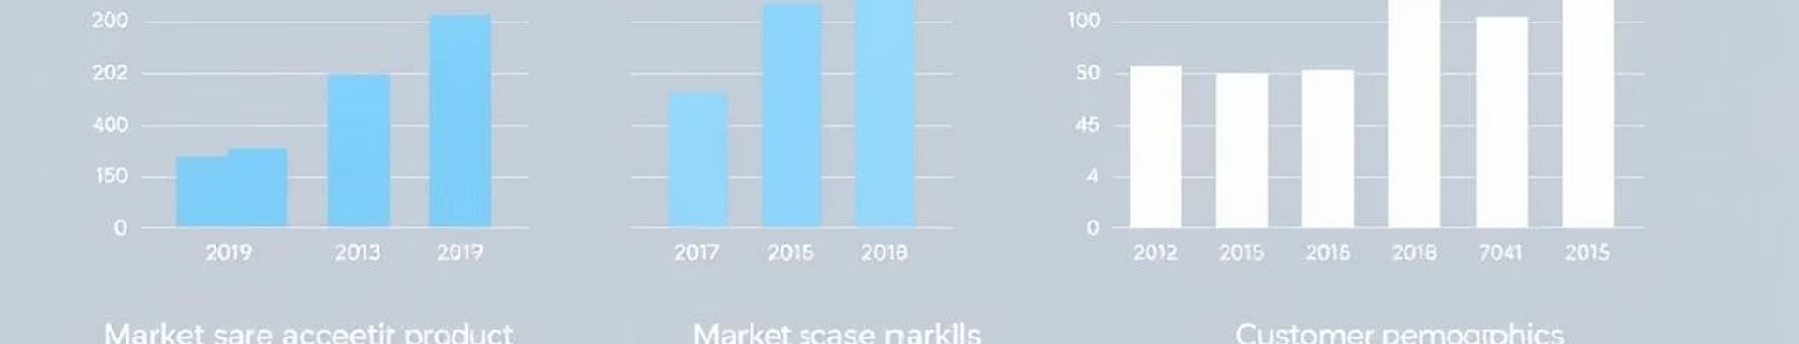
Why is EDA Essential?
1
Deep Understanding
2
Pattern Discovery
3
Error Detection
Gain insight into data distributions and relationships.
Visual tools can reveal trends and correlations.
Early identification of outliers and incorrect data entries.
4
Idea Generation
5
Effective Communication
Inspire new features or transformations to improve analysis.
Visuals and summaries simplify sharing insights with stakeholders.

Slide 7

Common Tools and Commands for EDA in Python
Task
Code
View summary stats
df.describe()
Check for nulls
df.isnull().sum()
Inspect data types
df.info()
Get data dimensions
df.shape
Create visualizations
sns.histplot(), boxplot(), scatterplot()

Slide 8



Libraries used:
pandas
data manipulation
matplotlib & seaborn
data visualization
Jupyter Notebook or Google Colab are great platforms for running EDA interactively.

Slide 9

Mini Example: Food Delivery Dataset
Suppose you’re analyzing a dataset of food delivery orders. During EDA, you might discover:
Evening Orders
Most orders occur during the evening
Missing Data
Some records have missing delivery timestamps
High Prices
A few prices are suspiciously high
Customer Insights
Customers from specific cities order more frequently
These insights are valuable, actionable, and would be easily missed without a proper EDA process.

Slide 10

Final Takeaway
EDA is not a one-time step. It’s a habit. Always begin by understanding your data. It will save time, deepen insight, and improve results.
By Awais Manzoor

Slide 11

Thank you!

